Slide 1
LG Boosting Algorithm
Light GBM is another efficient gradient boosting framework.
It uses a histogram-based approach to build trees, which speeds up training significantly.
It also supports parallel and distributed computing.
Its a Leaf wise tree growth.

Slide 2
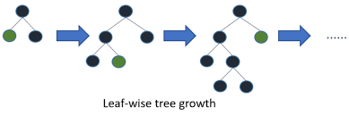
Diagram for LG Boosting

Slide 3
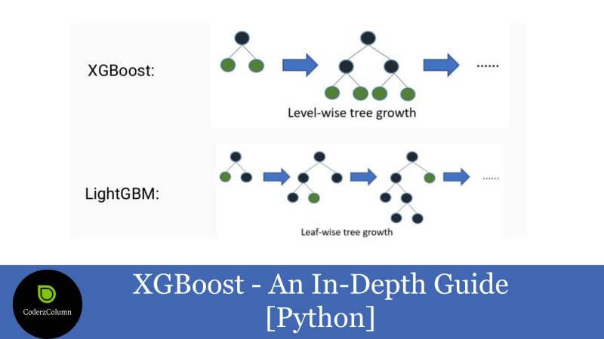
Difference between XG and LG Boosting

Slide 4
Hyperparameter Tuning
Tuning hyperparameters is crucial for optimizing LightGBM models.
Common hyperparameters to tune include num_leaves, max_depth, learning_rate, n_estimators, min_child_samples, and others.
When tuning hyperparameters, consider using techniques like grid search, random search, or Bayesian optimization.
Cross-validation is essential to ensure that your model's performance is robust across different data splits.
Additionally, monitor model performance metrics during tuning to identify the best combination of hyperparameters.

